Slide 1
Quantum Image Recognition
By Julian Blanco, Diego Vazquez

Slide 2
Classical Image Recognition
We take and image and feed pixel data into a Machine Learning Model
Model comprised of Convolutional and fully connected layers
Convolutional layers find similarities in pixel data
Fully Connected layers uses pixel data to make guesses on image classes

Slide 3
Motivation
Training ML models on large datasets takes a large amount of time
Want to see if Quantum Mechanics can increase training time and increase accuracy
Can try to help with the classification of incredibly large images

Slide 4
Methodology/Solution

Slide 5
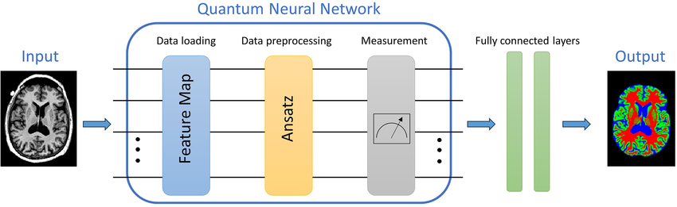
Hybrid Quantum Neural Network (HQNN)
It combines classical & deep learning architectures with QML algorithms
It uses a Parameterized Quantum Circuit to process data
Is able to process large datasets
Shown promise in healthcare, finance, chemical, & aerospace

Slide 6
Embedding
Encodes the input into quantum space
Resulting quantum state represents the input data

Slide 7
Variational Gates
Rotations with trainable parameters and subsequent CNOT operations
Transform data according to parameters
CNOT entangle qubits

Slide 8
Progress

Slide 9
Quantum Layer
Perform classification using quantum circuit
CIFAR10 dataset
Connect layer to classical model
Layer uses classical optimizer and loss function
Adam optimizer & Cross Entropy loss function

Slide 10
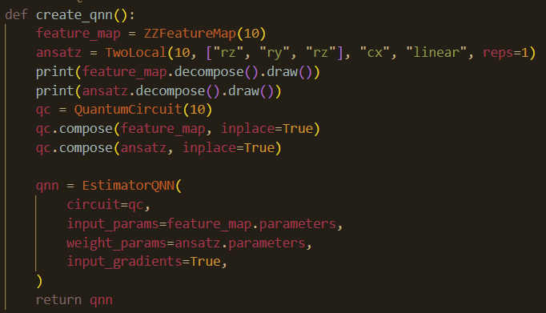
Quantum Layer Qiskit

Slide 11
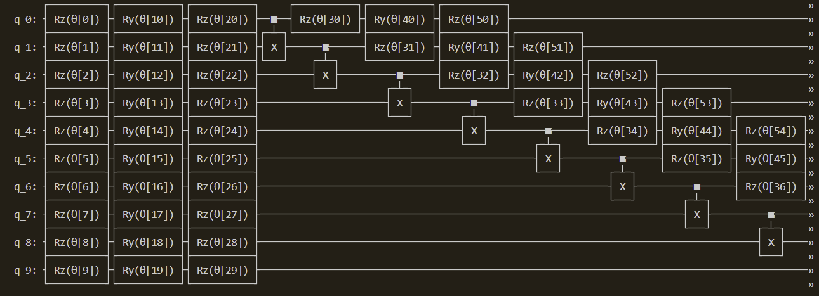
Rotation Circuit

Slide 12
Results

Slide 13
Loss and Accuracy
Model | Loss | Accuracy
Classical | 0.0470 | 98%
Hybrid | 2.4282 | 12%

Slide 14
Conclusion
Quantum layers not up to par with classical yet
More work needed to integrate quantum into classical

Slide 15
Thank you!

